Slide 1

A Division of Cheyenne
Regional Health System
Medical Neighborhoods Transform Rural Care Delivery
Role of Patient-Centered Primary Care Medical Homes
Presentation to Wyoming Medical Society
June 7, 2014
Phyllis Simpson Sherard, MPA, MHA, PhD
“The Health Care Innovation Award was supported by Funding Opportunity Number CMS-1C1-12-0001 from Centers for Medicare and Medicaid Services, Center for Medicare and Medicaid Innovation. Its contents are solely the responsibility of the authors and do not necessarily represent the official views of HHS or any of its agencies. Health Care Innovation Challenge (Cooperative Agreement) Opportunity Number CMS-1CI-12-001: CFDA:93.610”

Slide 2
Healthcare’s New Challenge
What do patients, payers, employers, politicians want?
Public, Commercial, Private Payers Alike
▪ High Quality
▪ Improved Population Health
= VALUE
We now have a mandate for physicians and hospitals to develop new forms of collaboration to achieve these goals.

Slide 3

A foot in both camps, but a divide we must cross
Paying for volume vs. paying for value
Paying for volume
Fragmented care
FFS
Treating sickness
Adversarial payors
Little HIT
Duplication &
waste
Paying for Pop Health
Value-based pmt
Seamless care
Fostering wellness
Payor partners
Integrated IT systems
Right care, right setting, right time
3

Slide 4
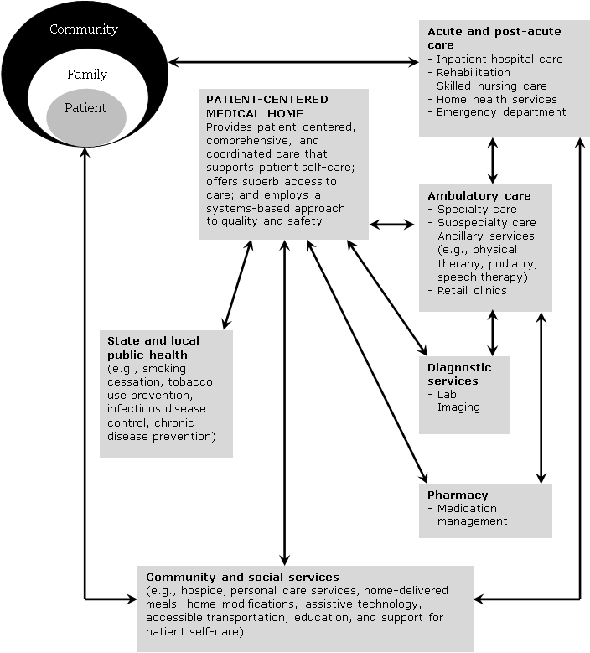
Change Theory: Medical Neighborhood Model
Taylor EF, Lake T, Mysenbaum J, Peterson G, Meyers D. Coordinating care in the medical neighborhood: critical components and available mechanisms.
White Paper (Prepared by Mathmatica Policy Research under Contract No. HHSA2902009000191 TO2). AHRQ Publication No. 11-0064. Rockville, MD: Agency for Healthcare Research and Quality. June 2011

Slide 5
MEDICAL NEIGHBORHOOD Strategies and partners

Slide 6
Health Care Innovation Award (Challenge Grant)
HCIA is a three year cooperative agreement; $14.6 million
WDH two year grant for $250,000
Grants supports the five strategies
  Scale PCMHs statewide
  Rural Care Transition Nurses in Hospitals
  Virtual Pharmacy (Medication Therapy Management linked to PCMHs)
  Expand Access to Donated Medications
  Physician Desktop/Enhanced Telehealth Capacity

Slide 7
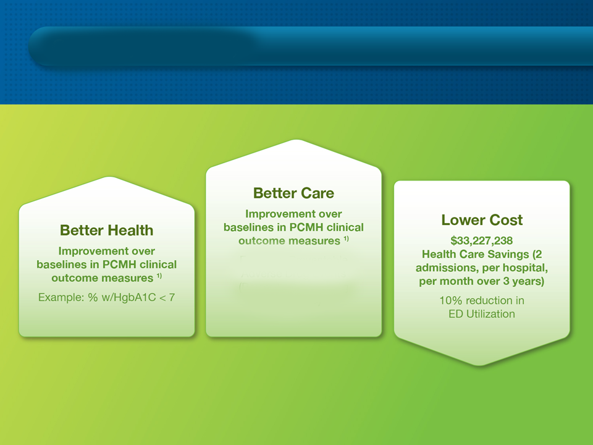
Goals (by 6/30/2015)
Medical Neighborhood Three Year Goals (By July 1 2015)
Example: Colorectal
Cancer screenings

Slide 8
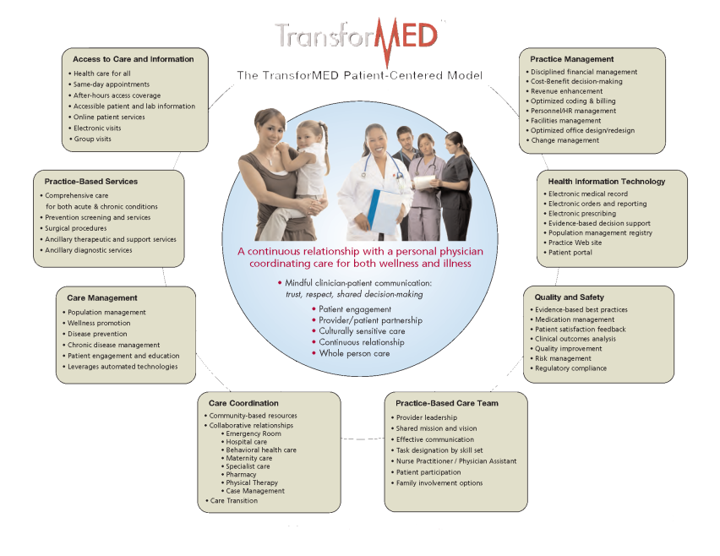
Patient-Centered Medical Home (PCMH) Components
A Medical Home for All

Slide 9
Practice Transformation Plans (PTPs)
Customized (PTPs) track the following areas:
Access to Care and Information
Practice-Based Services
Care Management
Practice Management
Health Information Technology
Quality and Safety
Practice-Based Care Team
Care Coordination

Slide 10
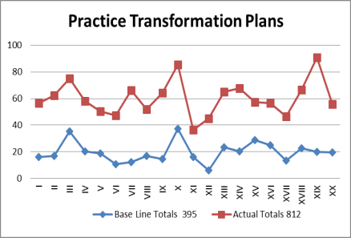
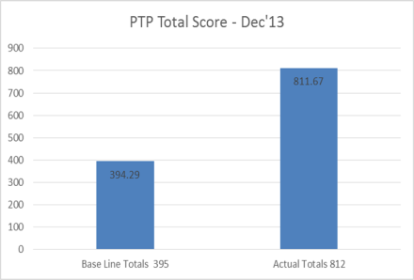
Practice Transformation Plans Tracking Patient-Centered Model Development
PTP Scores are updated quarterly; next round of scoring end of June 2014.

Slide 11
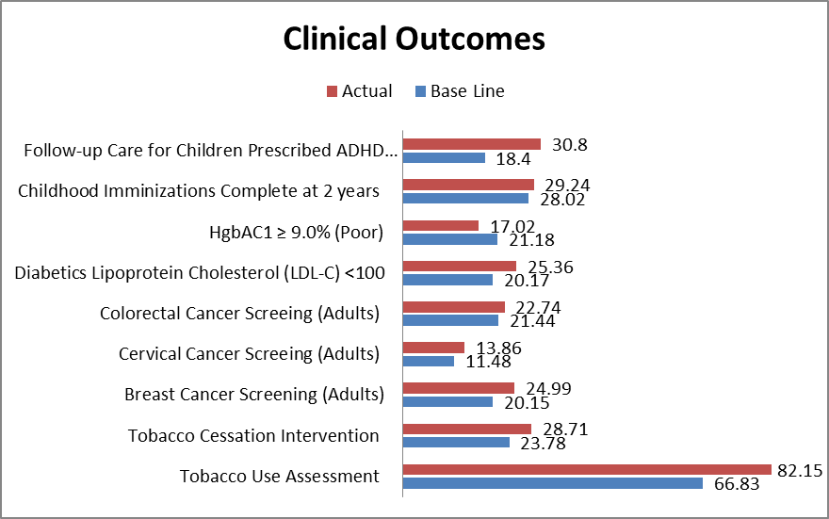
Clinical Outcome Indicators – Aggregate (6th Quarter)

Slide 12
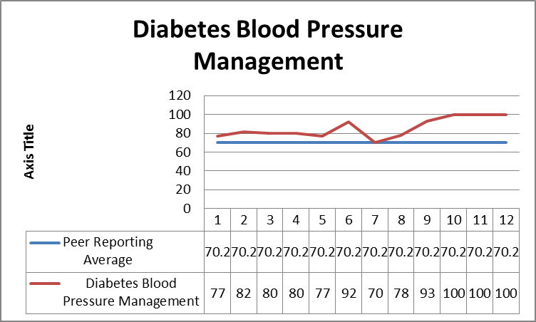
Sample De-identified Risk Measure; Comparison to Peer

Slide 13
NCQA Recognition Requirement
NCQA Scored Focus Areas
Enhance Access and Continuity
Identify and Manage Patient Populations
Plan and Manage Care
Provide Self-Care Support and Community Resources
Track and Coordinate Care
Measure and Improve Performance

Slide 14
NCQA Submission Status
NCQA submission
  Goal is January 31, 2015
  From now until January 31, PCMH gap assessment
  TransforMED will customize technical assistance to meet the assessed gaps
Negotiated discount and “mini-grants” help offset cost of application

Slide 15
PCMH Challenges
Maintaining strong Physician Champions – this is an 18-24 month journey…and beyond!
EHR Sophistication – understanding how to capture data that practices may never have had to access before, i.e. outcomes reporting and patient panel management.
PCMH and payment reform. What’s the ROI on all of this effort?
The rural settings of many practices limit their resources and staffing.

Slide 16
PCMH Payer Partners
Cooperative relationships with physicians, primary care providers
Counter incentives for supply-driven care
Reward medical homes for producing better health (not just more health care)
Patient care oriented to best outcomes
Medicaid, Blue Cross/Blue Shield of Wyoming, WINhealth, United, CIGNA (next year)

Slide 17

Expanded Access to Primary Care: Enroll Wyoming
Trusted messenger approach
Nearly 12,000 enrolled
Above national average for enrolling 18-34 YOA at 29%
55% Female; 45% Male
66% “Silver” plans; 23% “Bronze”
93% enrolled with financial assistance
www.Enrollwyo.org

Slide 18
Progress and Impact of Other Medical Neighborhood Strategies
Wyoming Rural Care Transition RNs
28 FTEs in 14 hospitals across Wyoming
Readmissions below 9% in a majority of the sites, compared to a national average of 21% for this population
Physician Desktop/Telehealth Solution
24 hospitals have completed upgrade to high definition endpoints
187 physicians using desktop webcam and mobile device connections
Clinical Telehealth consultation is on the rise across Wyoming; especially Tele-Psychiatry
Virtual Pharmacy – MTM Assistance
Nine Pharmacists and 7 pharmacies trained in population centers (Cheyenne, Casper, Jackson)
Medication Donation Program – Rx Access
20,404 prescriptions dispensed to 3,300 un/under-insured patients
Total value of donated medications re-dispensed is more than $1.26 million

Slide 19
27 TransforMED Primary Care Medical Homes; 7 Pharmacies Offering MTM
HCIA PCMH Practices (20):
Adult & Geriatric Medical Specialties – Ivinson Memorial Hospital
Basin Clinic
Big Horn Family Medicine
Big Horn Mountain Medicine (Sheridan)
Cheyenne Plaza Primary Care
Community Health Center of Central WY
Carol Fischer, MD
Jackson Whole Family Health
Kimball Health Services
Lander Medical Clinic
Memorial Clinics of Converse Co.
Midway Clinic
North Big Horn Hospital
Platte Valley Medical Center
Red Rock Family Practice
Rendezvous Clinic
St. Johns Family Health & Urgent Care
South Lincoln Medical Clinic
UW Family Medicine Residency – Casper
Western Medical Associates
Pre-HCIA Practices (7):
Babson & Associates
Cheyenne Health & Wellness Center
Sage Primary Care – Casper
UW Family Practice - Cheyenne
Cheyenne Regional Medical Group Clinics:
Cheyenne Children’s Clinics (2)
Cheyenne Family Medicine
Family First Primary Care
Virtual Pharmacy Participants
Cheyenne
Hoys Drugs
Town and Country
North Star Infusion
Casper:
Family Pharmacy
Walgreens (1071 CY Ave)
Walgreens (190 E Wyoming Blvd)
Riverton (Pending):
Smith’s Drug

Slide 20
28 Participating Hospitals – All Strategies; 14 Rural Care Transition Nursing Sites
Campbell Co Memorial Hospital*
Cheyenne Regional Medical Center*
Community Hospital – Torrington
Crook Co Memorial Hospital
Elkhorn Valley Rehabilitation Hospital
Evanston Regional Hospital
Hot Springs Co Memorial Hospital*
Ivinson Memorial Hospital*
Kimball Health Services (Nebraska)*
Lander Regional Hospital*
Memorial Hospital of Carbon Co*
Memorial Hospital of Converse Co*
Memorial Hospital of Sheridan Co
Memorial Hospital of Sweetwater Co*
* = Care Transition Sites
Niobrara Health & Life Center
North Big Horn Hospital*
Platte Co Memorial Hospital
Powell Valley Hospital
Riverton Memorial Hospital*
South Big Horn Co Hospital District
South Lincoln Medical Center
St. John’s Medical Center*
Star Valley Medical Center
Washakie Medical Center*
West Park Hospital
Weston Co Health Systems
Wyoming Behavioral Institute
Wyoming Medical Center*

Slide 21
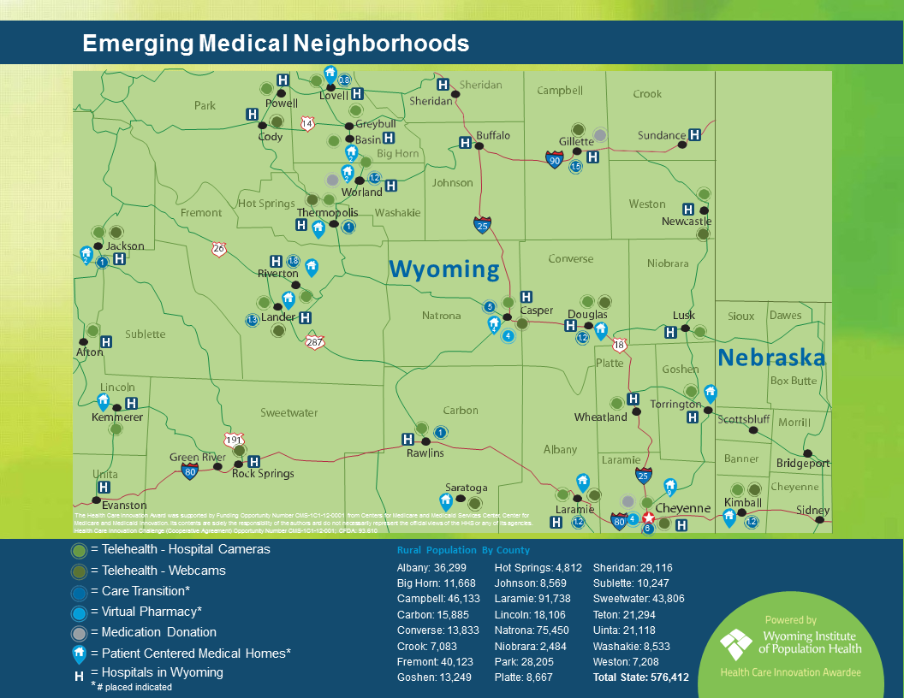
Martha’s two slides here

Slide 22
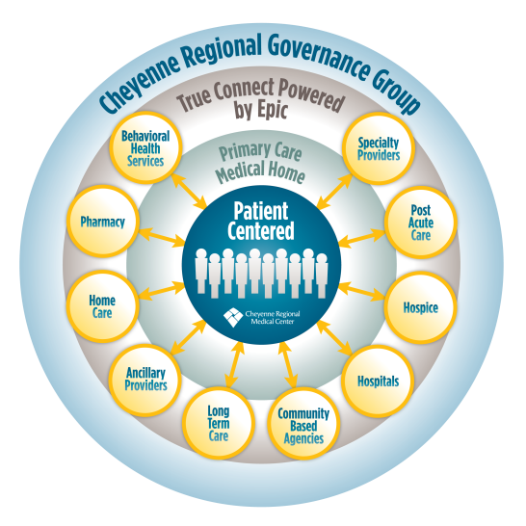
Cheyenne Regional’s Medical Neighborhood

